Slide 1
DATA ENGINEERING-2
Presented by:-
Eshitha Dhanaraj (11036071)
Paramesh Anil (11028138)

Slide 2
Table of Contents
Objective
Dataset Description
Tools and Technologies
Architecture
Project Demo
Business Questions
Visualization
Challenges Faced
Conclusions
Q&A

Slide 3
OBJECTIVE

Slide 4
OBJECTIVE
The Million Songs project #1 is a simulation of a music streaming service designed to demonstrate a data engineering pipeline using real-time data streaming.
It employs technologies like Kafka for data ingestion and Spark Streaming for processing, focusing on analyzing song popularity and user behavior.
The project aims to showcase the integration of these technologies in a realistic data engineering environment.

Slide 5
DATASET DESCRIPTION

Slide 6
DATASET DESCRIPTION
Source of Data: Our project uses Eventsim #2, a program that simulates event data for a fake music streaming service which uses Million Songs Dataset.
Data Characteristics: Eventsim generates data resembling real user activity, including song plays, user interactions, and system logs.
Data Structure: The dataset includes various fields like user ID, song ID, artist name, user location, and user agent (web browser).
Use in Project: This simulated dataset is used to mimic real-time streaming data, providing a realistic environment for data processing and analysis.

Slide 7
TOOLS AND TECHNOLOGIES

Slide 8
Tools & Technologies
Cloud - Google Cloud Platform
Infrastructure as Code software - Terraform #3
Containerization - Docker, Docker Compose
Stream Processing - Kafka, Spark Streaming
Orchestration - Airflow
Transformation - dbt
Data Lake - Google Cloud Storage
Data Warehouse - BigQuery
Data Visualization - Data Studio
Language - Python

Slide 9
ARCHITECTURE

Slide 10
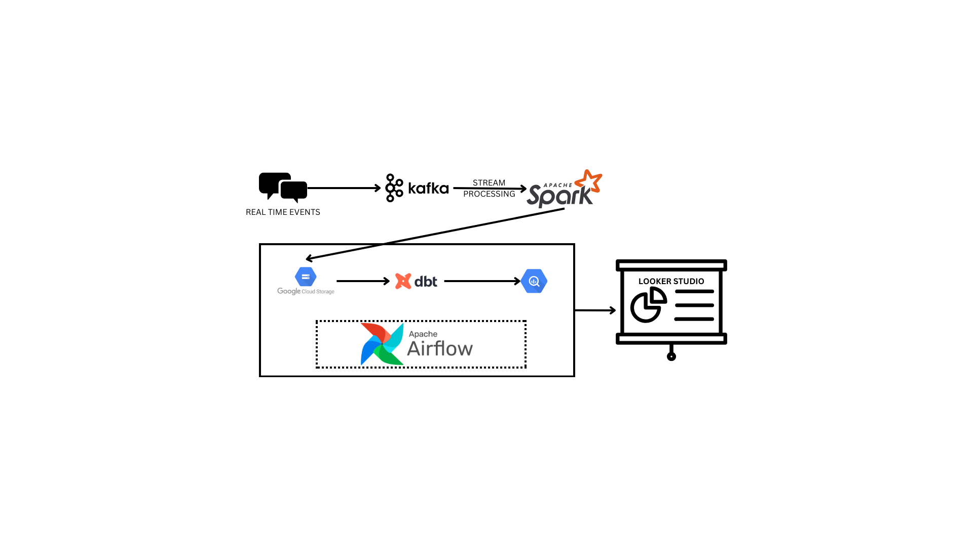
Notes:
Kafka - Kafka is a distributed event store and stream processing platform.
Spark is used for large scale data processing and provides an interface for programming clusters with data parallelism.

Slide 11
PROJECT DEMO

Slide 12



Slide 13
Business Questions

Slide 14
BUSINESS QUESTIONS
As a music enthusiast, a music critic wants to generate dynamic updates on the trending songs and the artists both geologically and based on number of streams and duration of play distinguished by cities, genders and age group of the users to provide dynamic recommendations in platforms like commerce websites, streaming platforms, or social media feeds.
Based on the popularity of top artists and songs, how can the music streaming service optimize its content strategy to cater to the preferences of its diverse user base?

Slide 15
Visualization

Slide 16
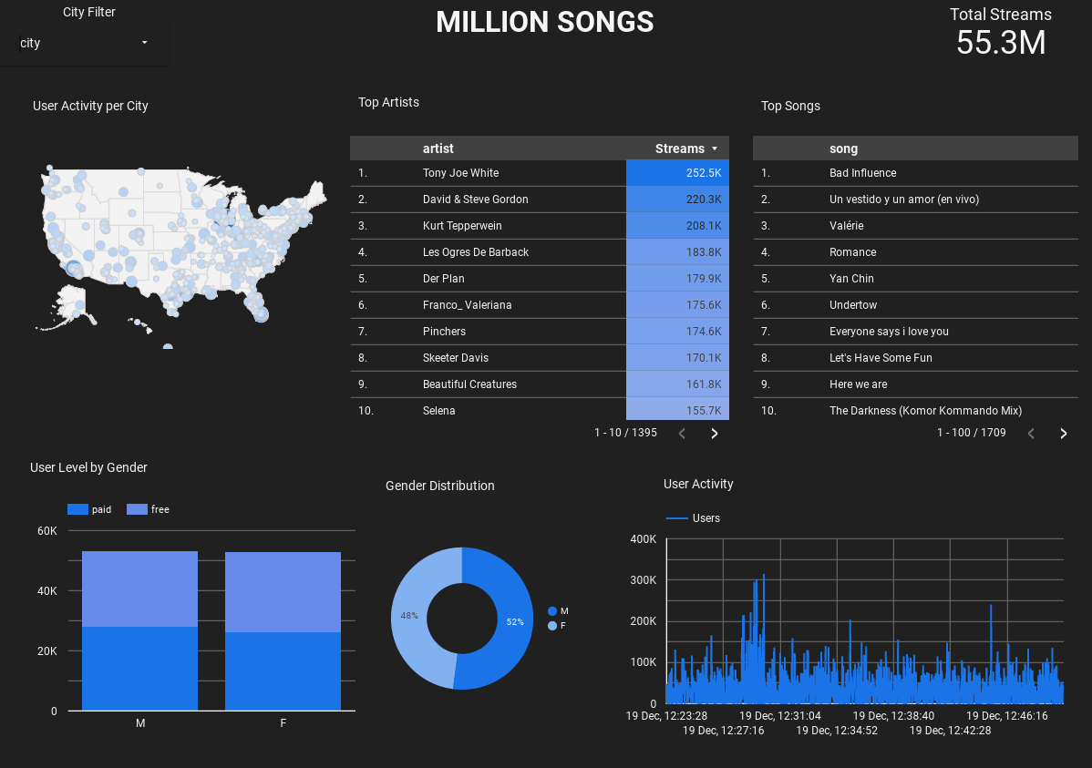

Slide 17
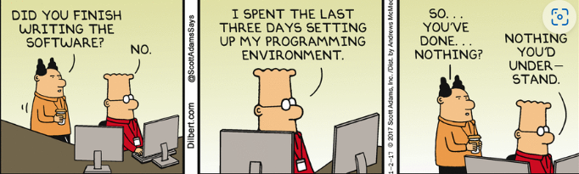
CHALLENGES FACED

Slide 18
CHALLENGES FACED
GCP Credits
Setting up the instances/Google Console manually.
Not sending messages to our Kafka broker with Eventsim.
Creating DAG for the dataset
Credits end up soon when we simulate more users and vice versa if the users are less there are no insights.

Slide 19
CONCLUSION
Efficient Data Pipeline: Million Songs establishes a robust data pipeline, seamlessly integrating event generation, real-time processing with GCP, and insightful visualization with Looker.
Real-Time Insights: Leveraging Spark Streaming and Airflow, the project delivers real-time analytics, unveiling valuable insights into user behaviors, popular songs, and user demographics.
Scalability and Flexibility: Google Cloud Platform's scalability ensures adaptability to evolving project needs, and Looker's modern analytics platform provides a flexible and user-friendly environment for data exploration.

Slide 20
Q & A

Slide 21
Thank You

Slide 22
References
Dataset link: http://millionsongdataset.com/
Eventsim: viirya/eventsim: Event data simulator. Generates a stream of pseudo-random events from a set of users, designed to simulate web traffic. (github.com)
Terraform: hashicorp/terraform: Terraform enables you to safely and predictably create, change, and improve infrastructure. It is a source-available tool that codifies APIs into declarative configuration files that can be shared amongst team members, treated as code, edited, reviewed, and versioned. (github.com)
Looker Studio Visualization Link: https://lookerstudio.google.com/reporting/8f3be2eb-157b-45c5-b86b-fe1a762008d3

